Slide 1
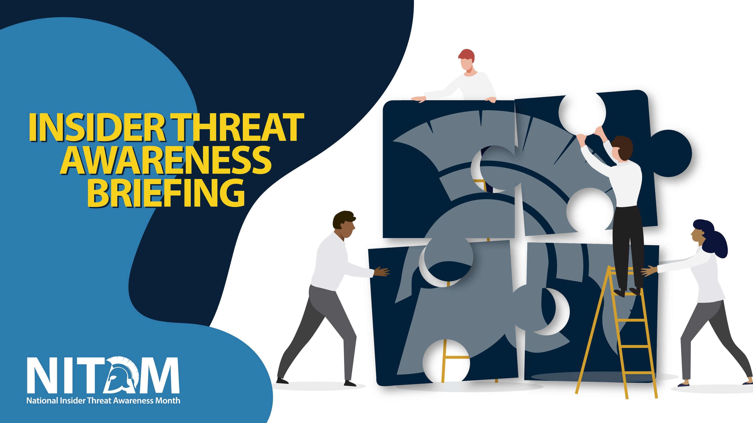
[INSERT AGENCY NAME HERE]

Slide 2

At the end of this brief, you will be able to:
INSIDER THREAT AWARENESS BRIEFING | LEARNING OBJECTIVES
Explain the importance of detecting and reporting potential insider threats
Identify indicators of insider threat behavior and procedures to report such behavior
Describe methodologies of adversaries to recruit trusted insiders and collect classified information
Understand counterintelligence and security reporting requirements

Slide 3
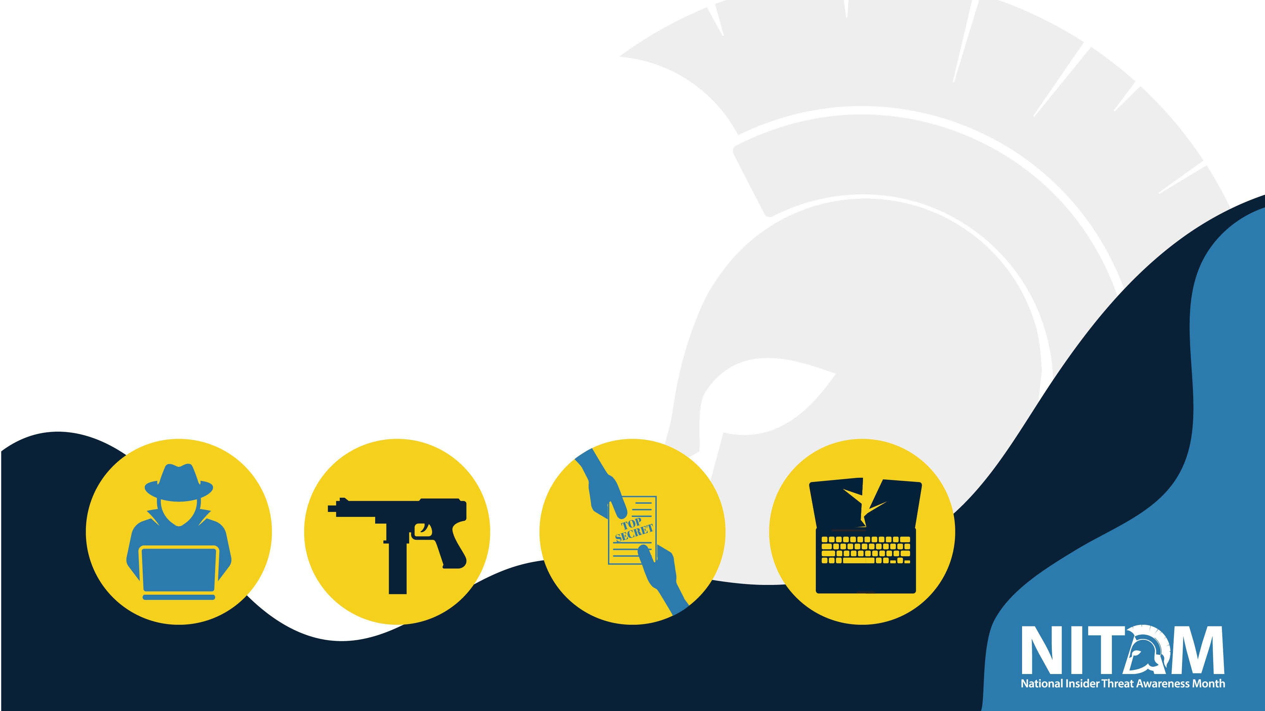
What is an Insider Threat?
INSIDER THREAT AWARENESS BRIEFING | DEFINITION
The threat an insider will use her or his authorized access wittingly or unwittingly, to do harm to the national security of the United States, their organization, or themselves.
This can include damage through espionage, workplace/kinetic violence, unauthorized disclosure of national security information, or through the loss or degradation of departmental resources or capabilities.

Slide 4

How does the damage occur?
INSIDER THREAT AWARENESS BRIEFING | MANIFESTATION
Espionage: Intelligence activity directed towards the acquisition of information through clandestine means.
Unauthorized Disclosure: A communication or physical transfer of classified information to an unauthorized recipient.
Workplace/Kinetic Violence: Any act of violent behavior, threats of physical violence, harassment, intimidation, bullying, verbal or non- verbal threat, or other threatening, disruptive behavior that occurs at or outside the work site, deliberate application of force to the human body with the intent to do harm.

Slide 5
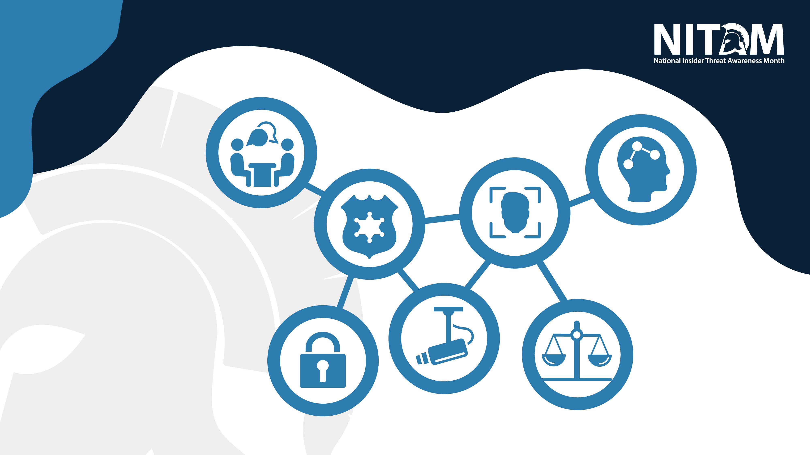
INSIDER THREAT AWARENESS BRIEFING | MITIGATION AND COMPLIANCE
Human Resources
Law Enforcement
Cybersecurity
How are Insider
Mental Health/ Behavioral Sciences
Threats mitigated?
Integrated Federal/DOD and Industry Insider Threat Programs (ITPs) with these seven core competencies:
Security
Legal
Counterintelligence

Slide 6
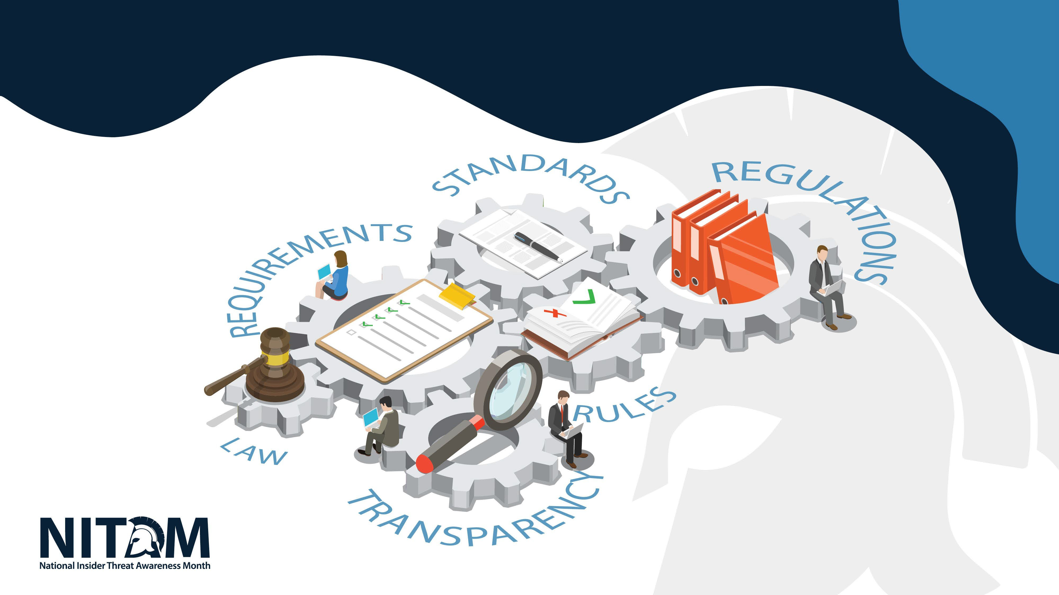
DoD/Federal Agency Insider Threat Programs
INSIDER THREAT AWARENESS BRIEFING | MITIGATION AND COMPLIANCE
Executive Order 13587
DoD Directive 5205.16
National Insider Threat Policy and Minimum Standards
National Industrial Security Program
United States authority for managing the needs of private industry to access classified information
32 Code of Federal Regulations Part 117 National Industrial Security Program Operation Manual (NISPOM)

Slide 7



All insider threat programs are required to protect the privacy and civil liberties of the workforce.
INSIDER THREAT AWARENESS BRIEFING | PRIVACY AND CIVIL LIBERTIES
The lawful exercise of first amendment rights and the use of legitimate whistleblowing channels to disclose fraud, waste, abuse or other questionable government activities are not considered actions of an Insider Threat.
Insider Threat Programs should regularly consult legal counsel before taking action.

Slide 8
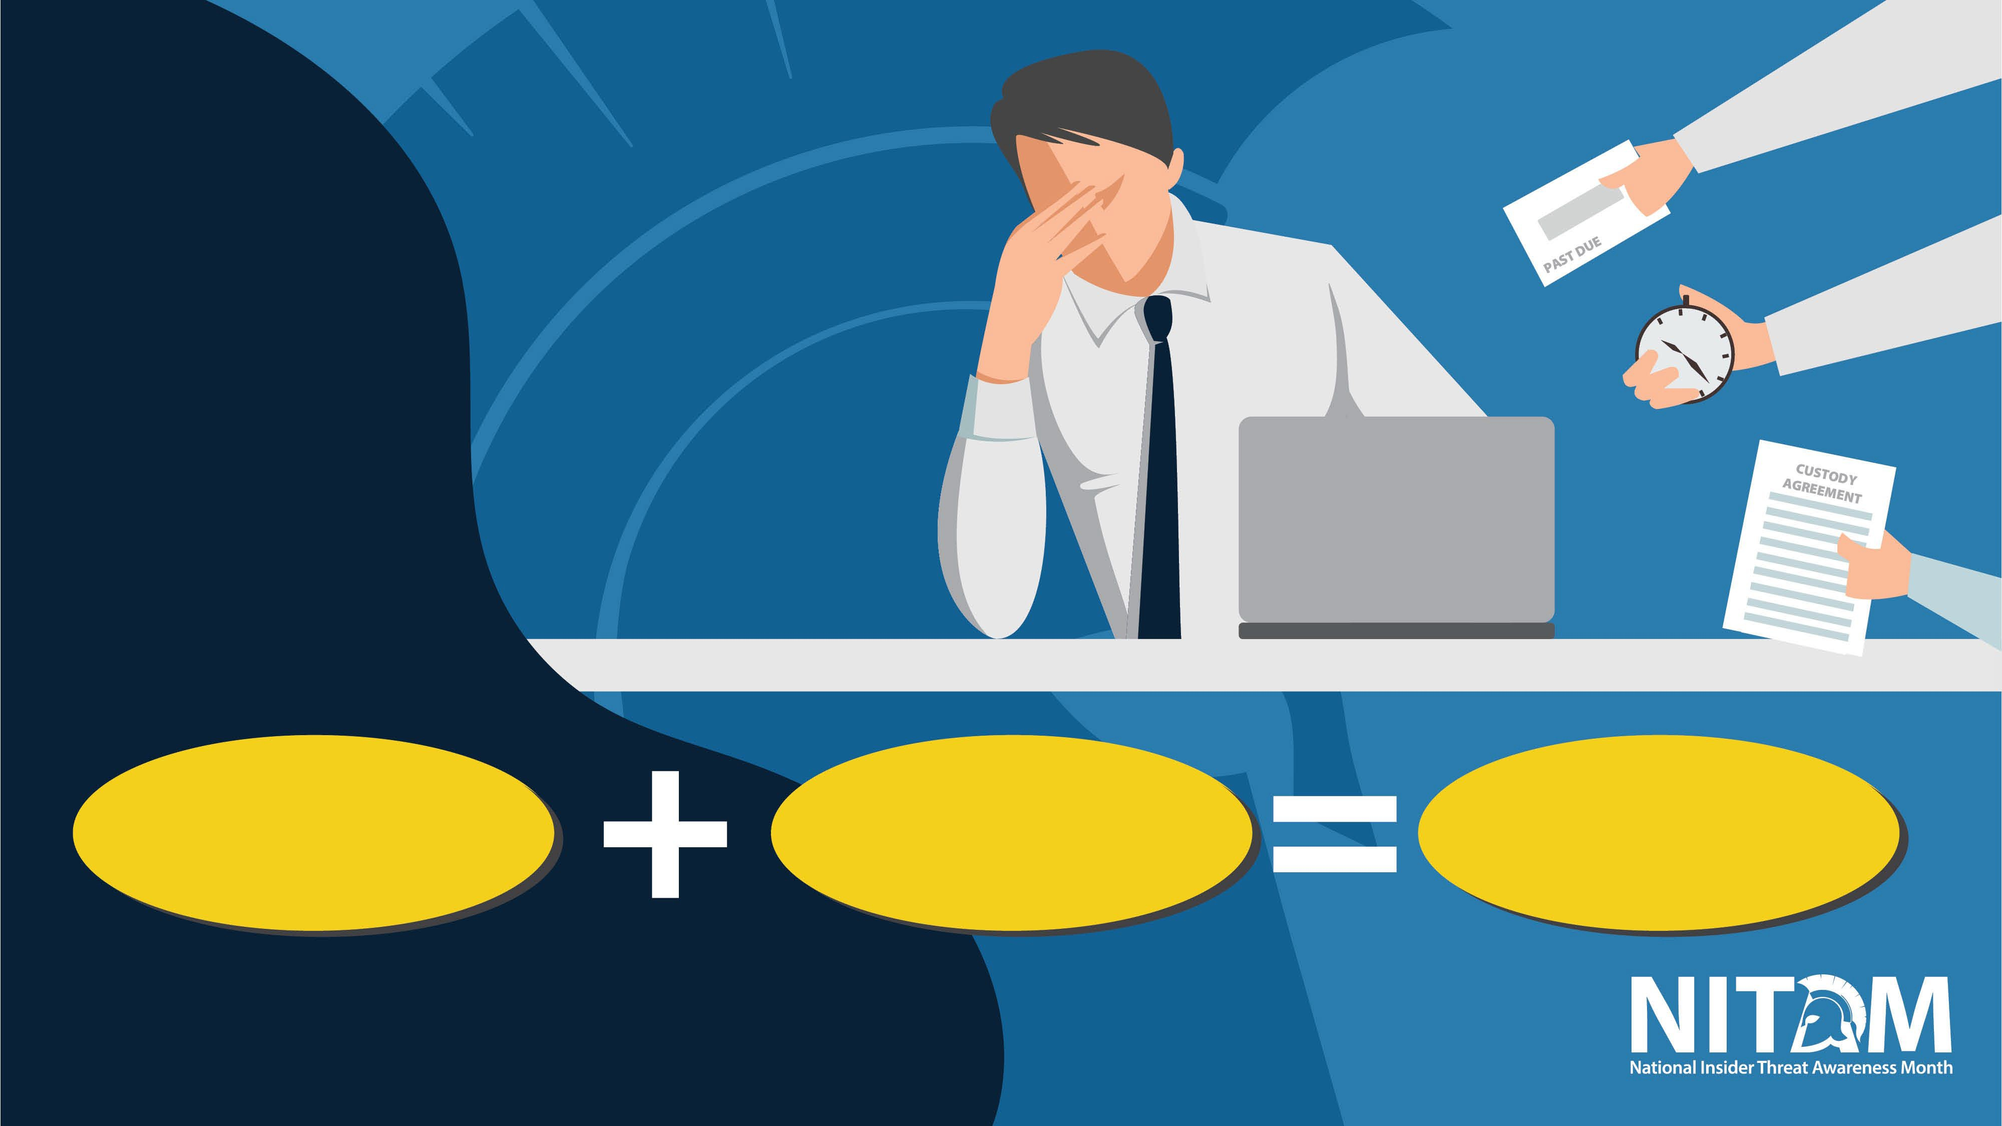
Who is the Insider
Threat?
INSIDER THREAT AWARENESS BRIEFING | IDENTIFICATION
Opportunity
Crisis
Vulnerability

Slide 9

Unawareness
INSIDER THREAT AWARENESS BRIEFING | POTENTIAL RISK INDICATORS (PRIs)
Complacency
Using personal storage devices for official business without authorization
Uploading sensitive files to a third a party site
Allowing individuals without access into buildings or workspaces
Unreported foreign contacts or travel
Drug or alcohol use in the workplace
Malice
Stealing sensitive information and sharing it for personal gain
Threatening violence against self or peers
Brandishing a weapon in the workplace
Attempting to access information or space not relevant to the work assignment
Unknowingly committing security infractions or violations
Misusing Government IT systems for non-work functions
Discussing sensitive information in public
Unknowingly clicking on a phishing scam
NOTE: Exhibiting PRIs does not necessarily mean someone is a threat. However, most insider threats exhibit one or more PRI

Slide 10


Observable PRIs may fall into these categories:
INSIDER THREAT AWARENESS BRIEFING | POTENTIAL RISK INDICATORS (PRIs)
Criminal, Violent or Abusive Conduct
Professional Lifecycle and Performance
Technical Activity Unexplained Affluence
Judgement, Character and Psychological Conditions
Security and Compliance Incidents

Slide 11
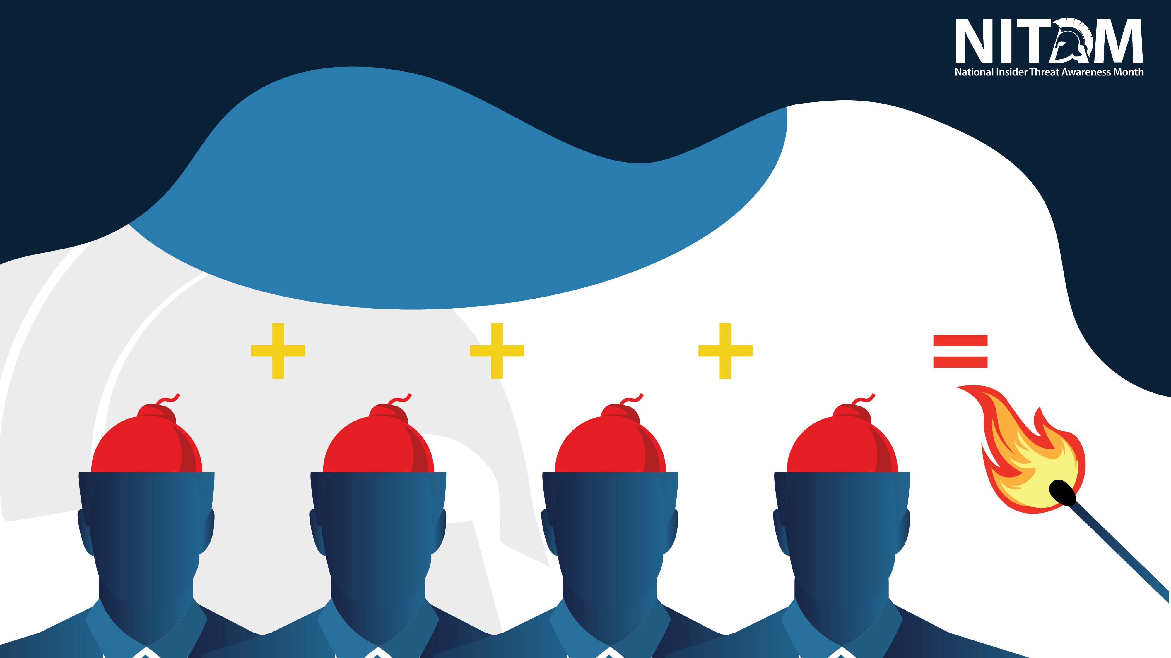
Indicators in Context
The Critical Path, a theory developed by Dr. Eric Shaw and Dr. Laura Sellers
INSIDER THREAT AWARENESS BRIEFING | POTENTIAL RISK INDICATORS (PRIs)
PROBLEMATIC ORGANIZATIONAL RESPONSES
PERSONAL PREDISPOSITIONS
CONCERNING BEHAVIOR
HOSTILE ACT
STRESSORS

Slide 12
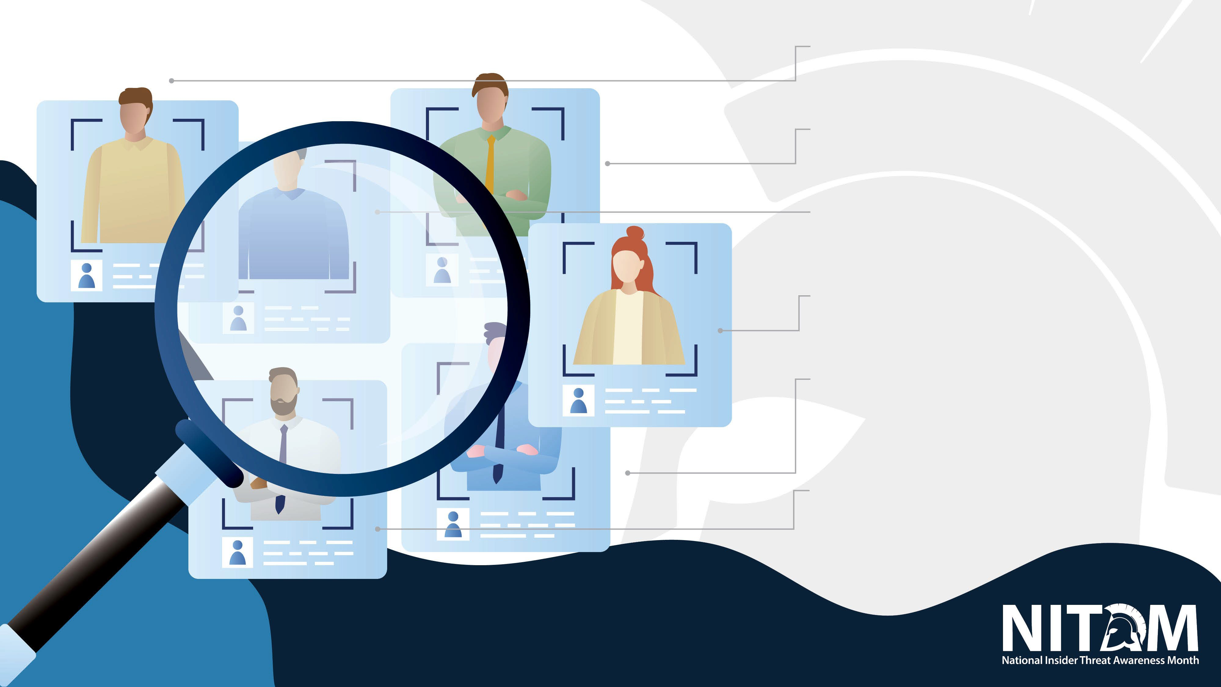
Christopher Paul Hasson
Criminal, Violent or Abusive Conduct
INSIDER THREAT AWARENESS BRIEFING | CASE STUDIES
Gabriel Romero
Professional Lifecycle and Performance
Shannon Stafford
Technical Activity
Candace Marie Claiborne
Unexplained Affluence
Ivan Lopez
Judgement, Character and Psychological Conditions
Henry Kyle Frese
Security and Compliance Incidents

Slide 13

PRIs:
INSIDER THREAT AWARENESS BRIEFING | CASE STUDIES
GABRIEL ROMERO
Access Attributes — Romero was qualified for armed Topside Roving Patrol, which involves continuously walking the area around the submarine, and therefore had access to weapons.
Professional Lifecycle and Performance – Romero had been formally disciplined for repeated tardiness and dereliction of duty. He also had been passed over for promotion due to his failure to pass the Naval Advancement Exam.
Judgement, Character, and Psychological Considerations – Prior to the incident, Romero had not been diagnosed with a mental disorder, but the Force Psychologist did assess him with a “Phase of Life Problem” and an “Unspecified Problem Related to Unspecified Psychosocial Circumstances.”
Impact:
Romero shot and killed two on-duty civilians and critically injuring another, and then killed himself while conducting Topside Roving Patrol on the USS Columbia at Pearl Harbor Naval Shipyard.

Slide 14

PRIs:
INSIDER THREAT AWARENESS BRIEFING | CASE STUDIES
HENRY KYLE FRESE
Security and Compliance Incidents:
Accessed information outside his scope of job duties
Provided classified national defense information via social media.
Failed to report suspicious requests from individuals relating to classified national defense information
Impact:
Frese created risk of exceptionally grave harm to the security of the United States through unauthorized disclosure by repeatedly passing classified information at the TS/SCI level to journalists, who published that information, sharing it with all of the nation’s adversaries.

Slide 15

PRIs:
INSIDER THREAT AWARENESS BRIEFING | CASE STUDIES
SHANNON STAFFORD
Declining work performance – Stafford’s work performance in his new role was problematic, leading to demotion and, ultimately, dismissal.
Disgruntlement –Stafford was disgruntled over his demotion, which fueled his further decline in performance.
Technical Activity – Stafford had tried to access company data several times before he succeeded.
Access attributes – Stafford’s position as an IT professional gave him the knowledge of other user’s credentials
Impact:
Stafford’s actions of deleting files and changing passwords to the storage management system caused severe disruption to the company’s operations and the loss of some customer and user data. It also hindered the company’s efforts to determine what happened and restore access to its remaining files. Stafford’s damage and attempted damage to their computer systems, including the cost of restoring the deleted systems, investigating what happened, and responding to the intrusion, was at least $38,270.

Slide 16

PRIs:
Unexplained affluence, frequent unreported foreign contact, attempts to conceal foreign travel, frequent personal travel beyond known income
INSIDER THREAT AWARENESS BRIEFING | CASE STUDIES
CANDACE MARIE CLAIBORNE
Impact:
Provided copies of internal documents from DoS on topics ranging from U.S. economic strategies to visits by dignitaries between two countries

Slide 17

IVAN LOPEZ
INSIDER THREAT AWARENESS BRIEFING | CASE STUDIES
PRIs:
Depression, anxiety, sleep disturbances, possible PTSD, recent deaths in the family, substandard performance, stressful PCS
Impact:
Wounded 14 other soldiers, killed three soldiers, left behind wife and children

Slide 18

PRIs:
INSIDER THREAT AWARENESS BRIEFING | CASE STUDIES
CHRISTOPHER PAUL HASSON
Association with extremist views, expressing ill will toward U.S. Government, Possessing illegal weapons and drugs, and misuse of U.S. Government automated information system
Impact:
This case exemplifies a positive insider threat outcome in that a hostile act was prevented by an effective insider threat program. Had his activities not been detected in time, he might have been able to carry them out against some individuals whom he researched and placed on target lists

Slide 19
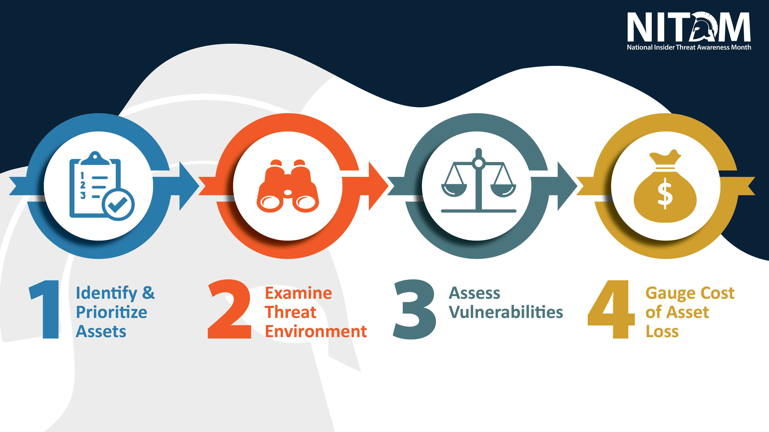
INSIDER THREAT AWARENESS BRIEFING | COUNTERINTELLIGENCE AND SECURITY

Slide 20
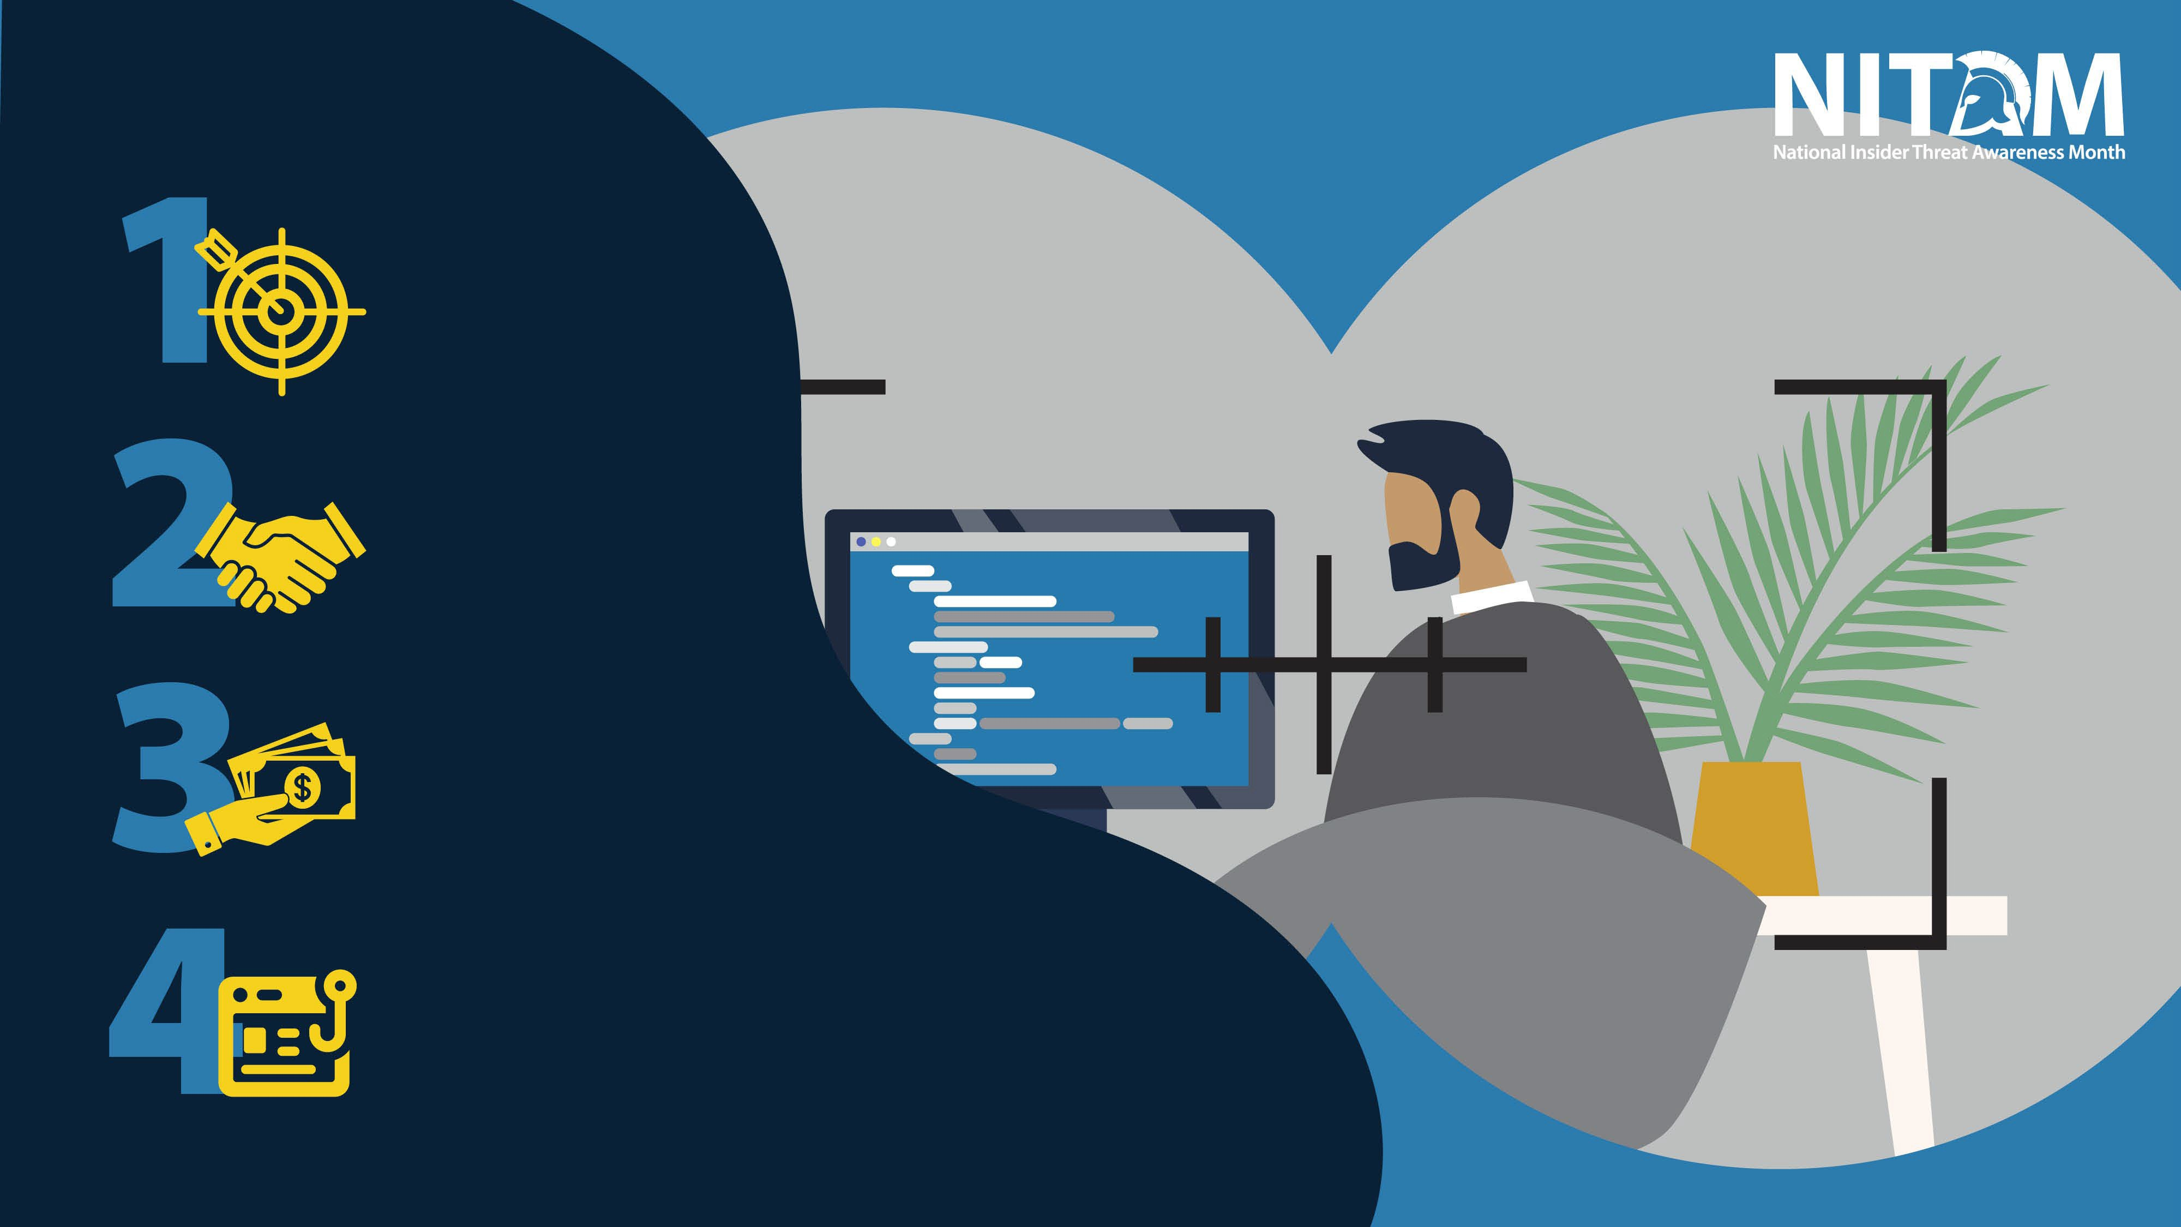
Spot & Assess
INSIDER THREAT AWARENESS BRIEFING | FOREIGN TARGETING AND RECERUITING
Develop
Recruit Elicit

Slide 21

DOD REPORTING
INSIDER THREAT AWARENESS BRIEFING | REPORTING POTENTIAL RISKS
DoD Directive 5240.06 Counterintelligence
Awareness and Reporting (CIAR) requires reporting contacts, activities, indicators and behaviors associated with foreign intelligence entities
DoDD 5205.16 requires reporting of Insider Threat Indicators
Immediately report suspicious activities, behaviors, and contacts to your supervisor, security, or insider threat program personnel

Slide 22

INDUSTRY REPORTING
INSIDER THREAT AWARENESS BRIEFING | REPORTING POTENTIAL RISKS
Report any incidents that meet thresholds of 32 CFR
Part 117 NISPOM, section 117.8. These include adverse information, security violations, personnel security issues, and suspicious contacts
Cleared contractors must also report actual, probable or possible espionage, sabotage, terrorism or subversion to both the Federal Bureau of Investigation (FBI) and Defense Counterintelligence & Security Agency (DCSA)
Immediately report suspicious activities, behaviors, and contacts to your supervisor, facility security officer, or insider threat program

Slide 23

FAILURE TO REPORT
INSIDER THREAT AWARENESS BRIEFING | LEARNING OBJECTIVES
DoD personnel who fail to report are subject to judicial or administrative action (or both) pursuant to applicable law and regulations.
UCMJ: Punitive action under article 92
Civilian employees: appropriate disciplinary action under regulation governing civilian employees
Industry personnel who fail to report are subject to disciplinary action (including termination), fines, prison, or a combination of all three

Slide 24

AWARENESS IS KEY

Slide 25

Agency SOP:
[NAME and LOCATION]
INSIDER THREAT AWARENESS BRIEFING | ORGANIZATION-SPECIFIC REPORTING
Insider Threat Reporting POC:
[NAME and CONTACT INFO]
Security POC:
[NAME and CONTACT INFO]
Counterintelligence Reporting POC:
[NAME and CONTACT INFO]

Slide 26
You should now be able to:
INSIDER THREAT AWARENESS BRIEFING | ORGANIZATION-SPECIFIC REPORTING
Explain the importance of detecting and reporting potential insider threats
Identify indicators of insider threat behavior and procedures to report such behavior
Describe methodologies of adversaries to recruit trusted insiders and collect classified information
Understand counterintelligence and security reporting requirements

